Slide 1
Drug designer database
Carlos Dominguez(Developer, Tester, scrum master, everything…) Product Owner: Dr. Luis Arroyo

Slide 2
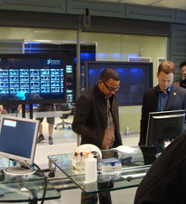

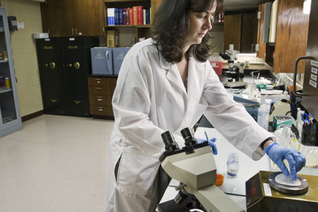
Presentation
What’s my project about?

Slide 3
Stories in spring 2
User Story | Estimated | Current
#117 guest user download class info | 8 | 9
#225 delete class | 2 | 2
#224 edit class | 2 | 2
#223 create class | 2 | 3
#109 edit compound | 8 | 9
#191 import compound | 16 | 15
#190 delete compound | 4 | 4
#181 create contact us | 8 | 7
#189 add new compound | 8 | 8
 | 58 | 59 | Total
59 ---- = 1.47 points per hour 40
Total Speed =

Slide 4
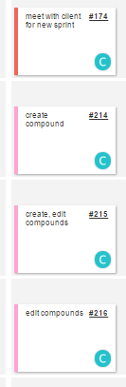
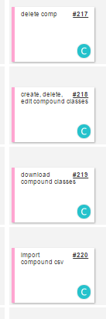
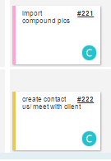
Mingle Daily Scrum

Slide 5
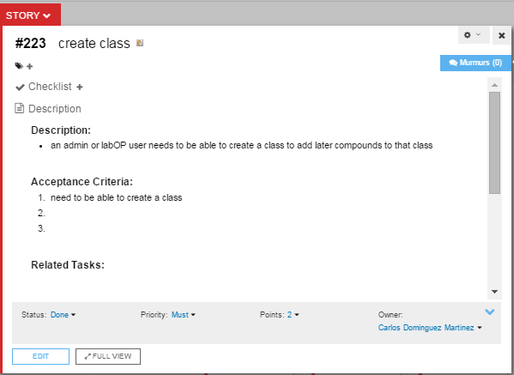
Invite Use Case

Slide 6
Use Case
Name: 223_create_class
Participating actor: admin user or labOP
Entry condition: User is logged in the system User is in their manageClasses page. User has admin or LabOP rights
Exit condition: User invite is sent
Event flow: User click on the Add Class button on manageClasses view system shows a popup on the manageClasses view User enter the name of the class on the pop up text box User clicks the add button on the pop up. System shows confirmation on whether class was added or not

Slide 7
Documents
User Manual : features added

Slide 8
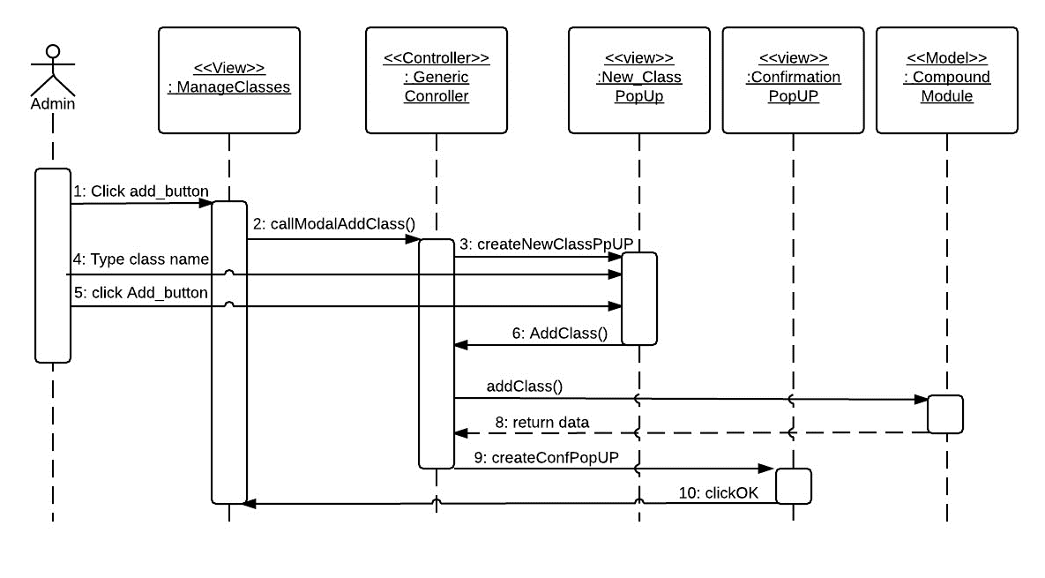
Invite new user sequence Diagram

Slide 9
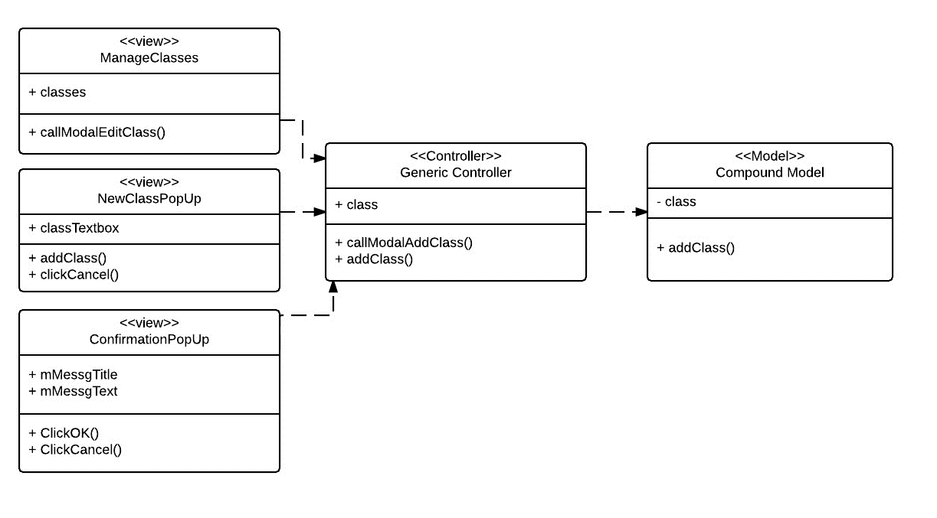
Class diagram

Slide 10
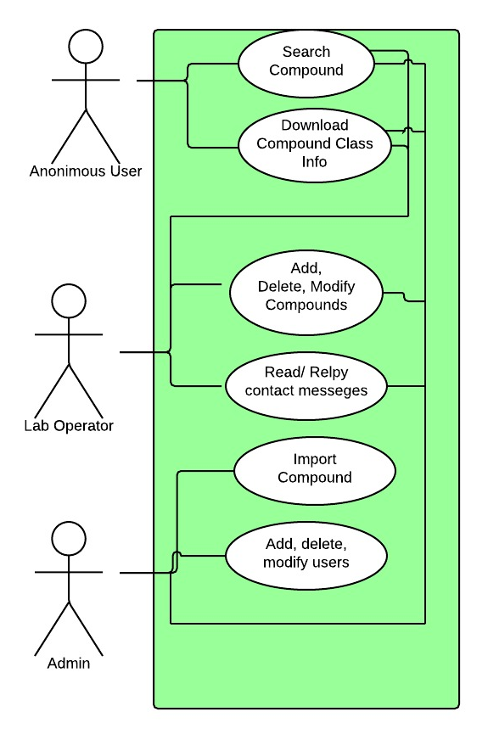
Use Case Diagram

Slide 11
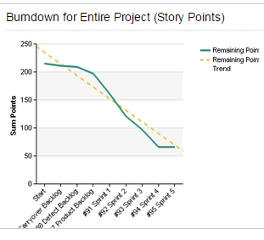
BurnDown Chart
All story points were finished

Slide 12
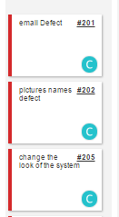
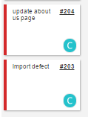
Current Sprint

Slide 13
More Documentation
Installation and maintenance: added

Slide 14
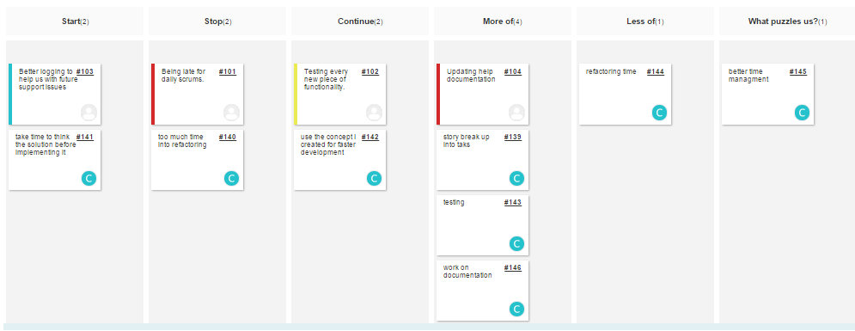
Retrospective

